Slide 1
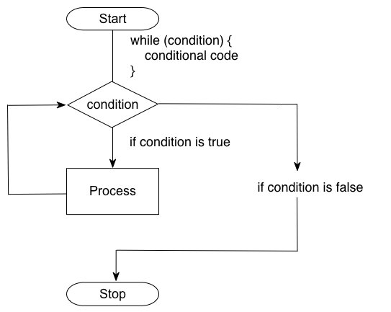
Flow of Control
Kevin Cunningham

Slide 2

Plan for Session
If statement
Using else and elif
Nesting if statements
Comparison Operators
Logical Operators
If expressions
True and False
While Loops
For loops
Break and Continue

Slide 3

The if Statement
Layout is key in Python;
It helps define structure of pgm
Basic structure - note indentation
Simple example
Extending the example
if <condition-evaluating-to-boolean>:
statement
num = int(input('Enter a number: '))
if num > 0:
print(num, 'is positive')
Enter a number: 1
1 is positive
num = int(input('Enter another number: '))
if num > 0:
print(num, 'is positive')
print(num, 'squared is ', num * num)
print('Bye')
Enter another number: 2
2 is positive
2 squared is 4
Bye

Slide 4
Using else and elif
Optionally can have else
Also, additional conditional tests
num = int(input('Enter yet another number: ')) if num < 0: print('Its negative') else: print('Its not negative')
Enter yet another number: 1
Its not negative
Enter yet another number: -1
Its negative
savings = float(input("Enter how much you have in savings: ")) if savings == 0: print("Sorry no savings") elif savings < 500: print('Well done') else: print('Thank you')
Enter how much you have in savings: 400
Well done
Notes:
Can have multiple elif conditions

Slide 5
Nesting if statements
Can nest one if statement inside another
snowing = True
temp = -1
if temp < 0:
print('It is freezing')
if snowing:
print('Put on boots')
print('Time for Hot Chocolate')
print('Bye')
Note style of checking for snowing – it is already a bool
It is freezing
Put on boots
Time for Hot Chocolate
Bye

Slide 6
Comparison Operators
Return True or False
Operator | Description | Example
== | Tests if two values are equal | 3 == 3
!= | Tests that two values are not equal to each other | 2 != 3
< | Tests to see if the left-hand value is less than the right-hand value | 2 < 3
> | Tests if the left-hand value is greater than the right-hand value | 3 > 2
<= | Tests if the left-hand value is less than or equal to the right-hand value | 3 <= 4
>= | Tests if the left-hand value is greater than or equal to the right-hand value | 5 >= 4

Slide 7
Logical Operators
Combine Boolean expression together
Can use logical operations
to combine Boolean conditions together
Operator | Description | Example
and | Returns True if both left and right are true | 3 < 4 and 5 > 4
or | Returns True if either the left or the right is true | 3 < 4 or 3 > 5
not | Returns True if the value being tested is False | not 3 < 2
age = 15 status = None if age > 12 and age < 20: status = 'teenager' else: status = 'not teenager' print(status)
teenager

Slide 8
If expressions
Shorthand form of an if statement
returns a value
has the from
An example
<result1> if <condition-is-met> else <result2>
age = 15
status = 'teenager' if age > 12 and age < 20 else 'not teenager' print(status)
teenager

Slide 9
A note on True and False
Python is flexible on what is equivalent to True and False
0, '' (empty strings), None equate to False
Non zero, non empty strings, any object equate to True
Best practice is to use True and False

Slide 10
While (conditional) loops
No do-while in Python
Basic form
again note the indentation (very important)
An example
while <test-condition-is-true>: statement or statements
valid_data = False while not valid_data: age = int(input('Please enter your age: ')) if age < 0 or age > 120: print('invalid Age') else: valid_data = True print() # not part of the while loop print('Done')
Please enter your age: -1
invalid Age
Please enter your age: 130
invalid Age
Please enter your age: 21
Done

Slide 11
For Loop
Basic form iterates over an iterable
note the indentation
Example
Can also do
for <variable-name> in range(...):
statement
# Loop over a set of values in a range print('Print out values in a range')
for i in range(0, 10): print(i, ' ', end='')
print() print('Done')
Print out values in a range
0 1 2 3 4 5 6 7 8 9
Done
for i in range(0, 10, 2): # increments by 2 print(i, ' ', end='')
Notes:
Can also have an increment value # Now use values in a range but increment by 2 print('Print out values in a range with an increment of 2') for i in range(0, 10, 2): print(i, ' ', end='') print() print('Done’)
Can also do 10, 0, -2 to count down

Slide 12

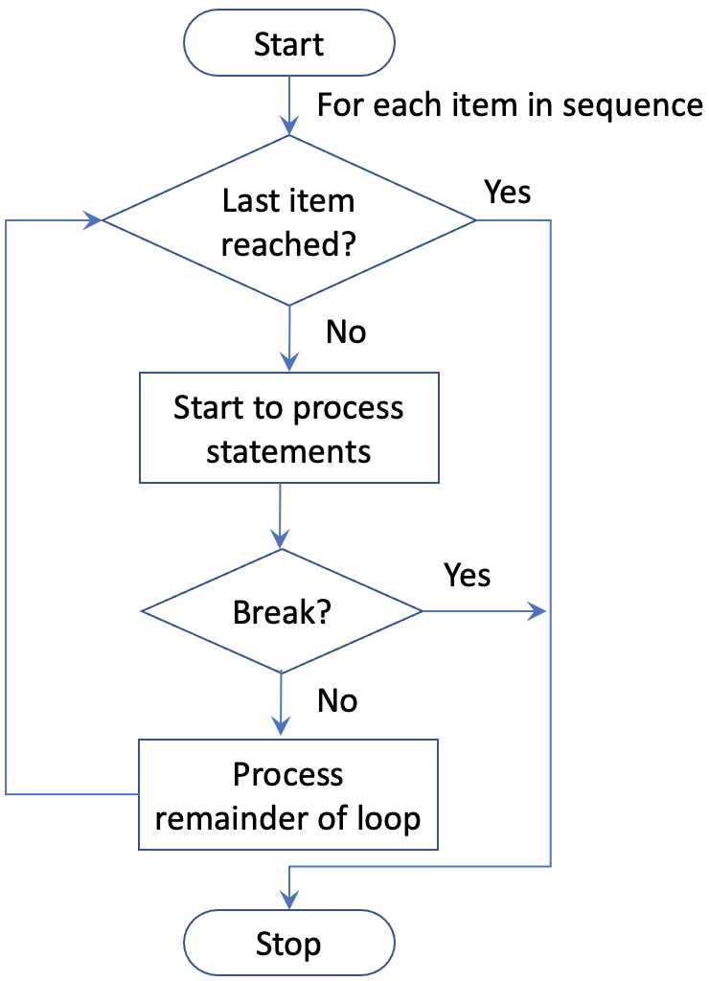
Break loop statement
Can choose to break out of a loop
num = int(input('Enter a number to check for: ')) for i in range(0, 6): if i == num: break print(i, ' ', end='')
print('Done')
Enter a number to check for: 7
0 1 2 3 4 5 Done
Enter a number to check for: 3
0 1 2 Done

Slide 13
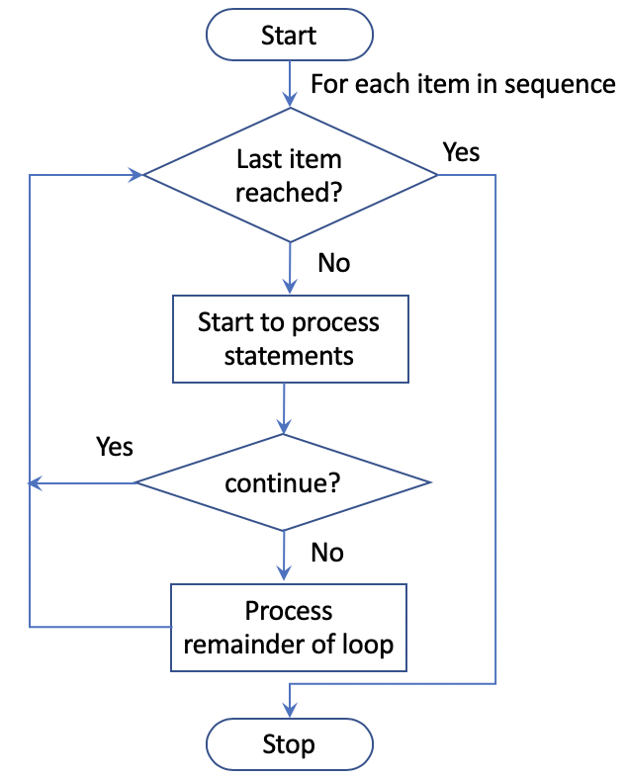
Continue loop statement
Can choose just to skip current iteration
for i in range(0, 10): print(i, ' ', end='') if i % 2 == 1: continue print('hey its an even number') print('we love even numbers')
print('Done')
0 hey its an even number
we love even numbers
1 2 hey its an even number
we love even numbers
3 4 hey its an even number
we love even numbers
5 6 hey its an even number
we love even numbers
7 8 hey its an even number
we love even numbers
9 Done

Slide 14
Questions?
?

